Slide 1
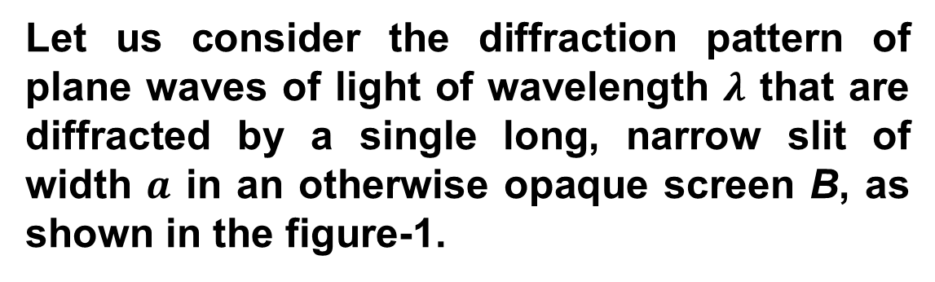
Lecture 24: Diffraction
General Equation of Diffraction Minima by a Single-Slit:
Let us consider the diffraction pattern of plane waves of light of wavelength $λ$ that are diffracted by a single long, narrow slit of width $a$ in an otherwise opaque screen B, as shown in the figure-1.
When the diffracted light reaches viewing screen C, waves from different points within the slit undergo interference and produce a diffraction pattern of bright and dark fringes on the screen.
figure-1

Slide 2

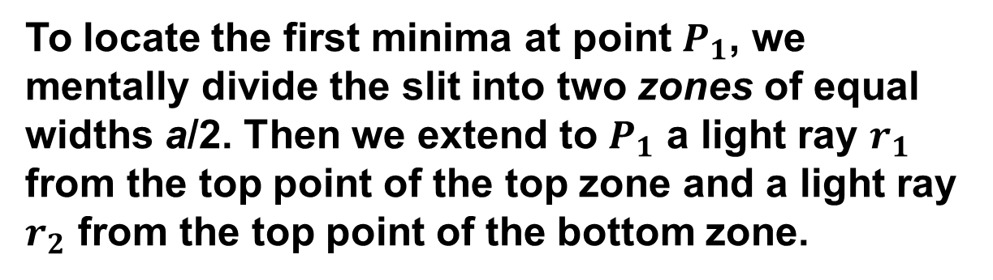

To locate the first minima at point $P_{1}$, we mentally divide the slit into two zones of equal widths a/2. Then we extend to $P_{1}$ a light ray $r_{1}$ from the top point of the top zone and a light ray $r_{2}$ from the top point of the bottom zone.
These two rays must be out of phase by $\frac{λ}{2}$ when they reach $P_{1}$; this phase difference is due to their path length difference.
figure-1
For $D>>a$in figure-2 the path length difference between rays $r_{1}$ and $r_{2}$ is then equal to $\frac{a}{2}\sin{θ}$.
figure-2

Slide 3

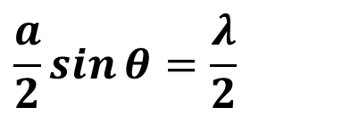
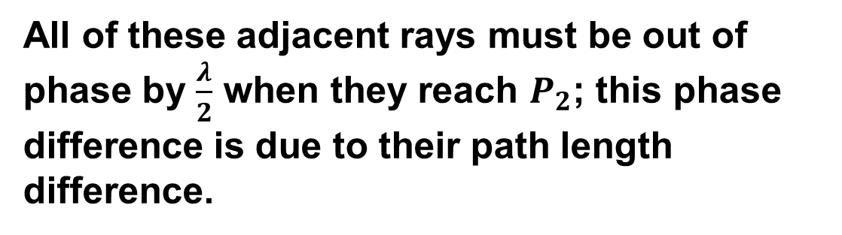
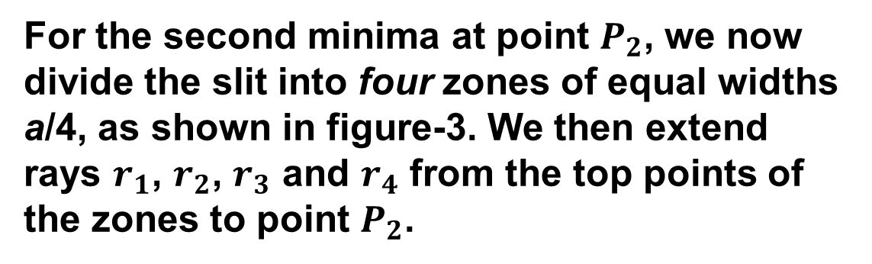
$$\frac{a}{2}\sin{θ}=\frac{λ}{2}$$
Thus for the first minima,
⇒ $a\sin{θ=λ}$
For the second minima at point $P_{2}$, we now divide the slit into four zones of equal widths a/4, as shown in figure-3. We then extend rays $r_{1}$, $r_{2}$, $r_{3}$ and $r_{4}$ from the top points of the zones to point $P_{2}$.
All of these adjacent rays must be out of phase by $\frac{λ}{2}$ when they reach $P_{2}$; this phase difference is due to their path length difference.
figure-3

Slide 4
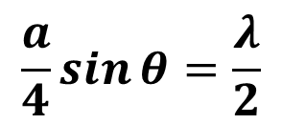


For $D>>a$in figure-4, the path length difference between the adjacent rays is equal to $\frac{a}{4}\sin{θ}$.
$$\frac{a}{4}\sin{θ}=\frac{λ}{2}$$
Thus for the first minima,
⇒ $a\sin{θ=2λ}$
Similarly, other minima can be located in the diffraction pattern by splitting up the slit into more zones of equal width.
Thus the general equation of diffraction Minima is,
$$a\sin{θ=mλ [ m=1,2,3………]}$$
figure-4

Slide 5
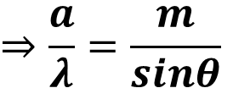

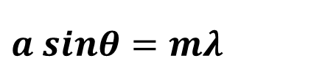
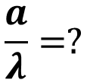
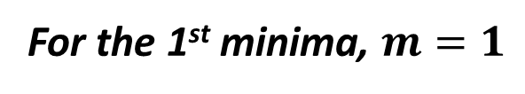
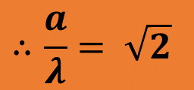

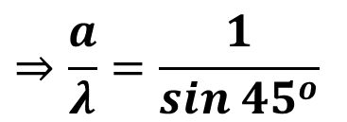
2. What must be the ratio of the slit width to the wavelength for a single slit to have the first diffraction minimum at $θ = 45.0°?$
$$Given,$$
$$θ = 45.0°$$
For the 1st minima, $m=1$
$$\frac{a}{λ}=?$$
$$a sinθ=mλ$$
$$⇒\frac{a}{λ}=\frac{m}{sinθ}$$
$$⇒\frac{a}{λ}=\frac{1}{sin {45}^{o}}$$
$$∴\frac{a}{λ}= \sqrt{2}$$

Slide 6

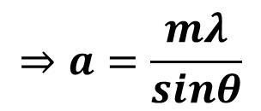
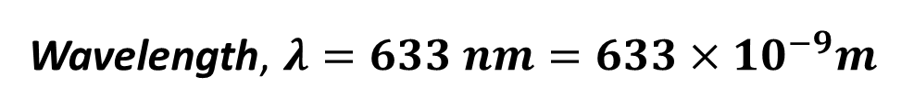
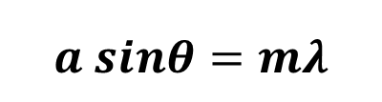




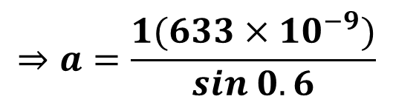
7. Light of wavelength 633 nm is incident on a narrow slit. The angle between the first diffraction minimum on one side of the central maximum and the first minimum on the other side is 1.20°. What is the width of the slit?
$$Given,$$
Wavelength, $λ=633 nm=633×{10}^{−9}m$
For the 1st minima, $m=1$
Angle between two diffraction minima, $2θ =1.2°$
$$∴θ =0.6°$$
Width of the slit, $a=?$
$$a sinθ=mλ$$
$$⇒a=\frac{mλ}{sinθ}$$
$$⇒a=\frac{1(633×{10}^{−9})}{sin 0.6}$$
$$∴a=60448×{10}^{−9}m$$

Slide 7
Additional problem:
Sample problem 36.01, page: 1085

